Slide 1
Solar radiation prediction

Slide 2
Data variables
UNIX Time
Date
Time
Radiation
Temperature
Pressure
Humidity
Wind Direction
Speed
Sun Rise Time
Sun Set Time

Slide 3
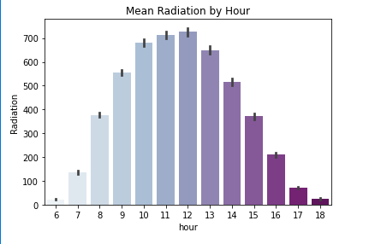
Mean Radiation by Hour

Slide 4
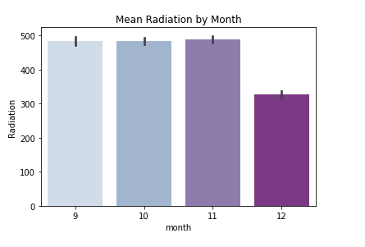
Mean Radiation by Month

Slide 5
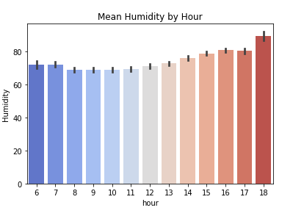
Mean Humidity by Hour

Slide 6
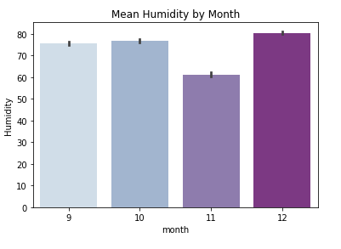
Mean Humidity by Month

Slide 7
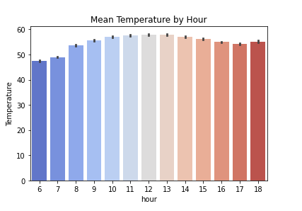
Mean Temperature by Hour

Slide 8
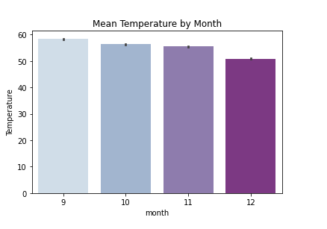
Mean Temperature by Month

Slide 9
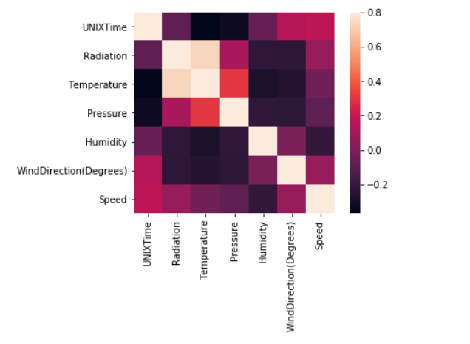
Variable correlation - Heatmap

Slide 10
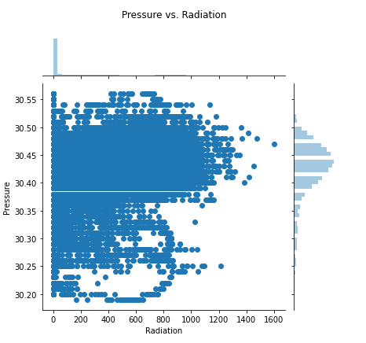
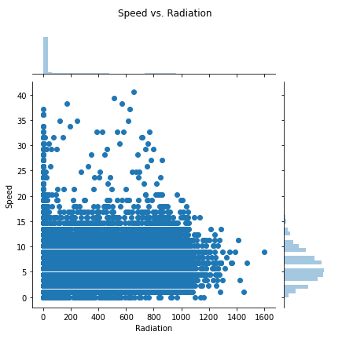
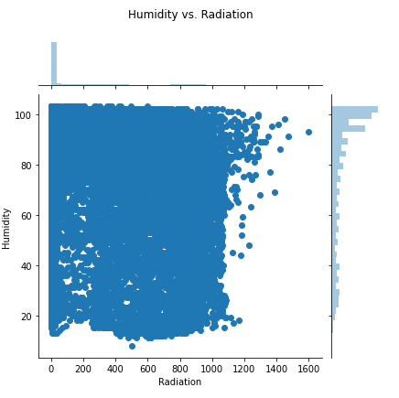
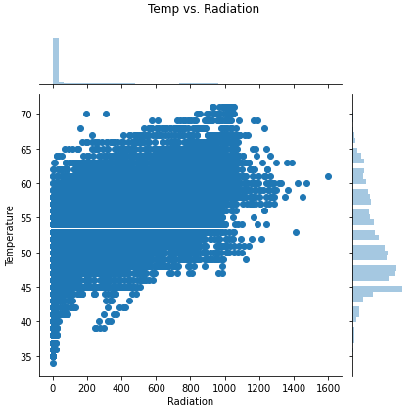
Effect of different variables on Radiation

Slide 11
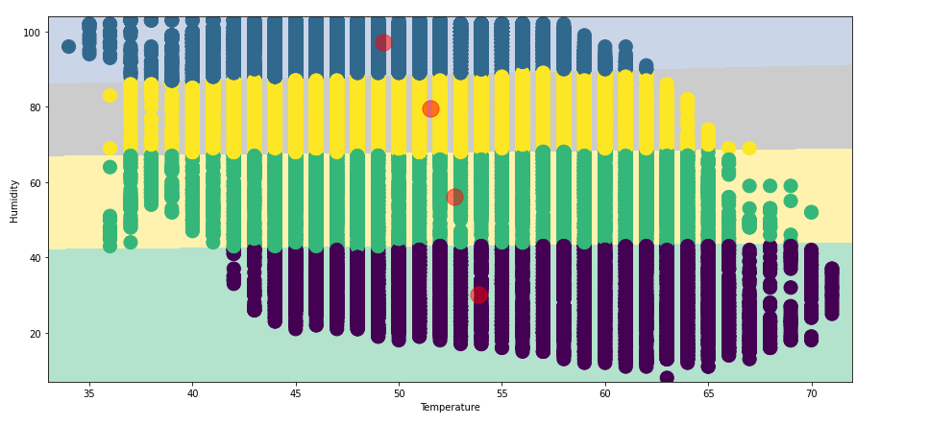
Variable interdependency Temperature vs Humidity
As Temperature increases the Humidity decreases. As air temperature increases, air can hold more water molecules, and its relative humidity decreases.

Slide 12
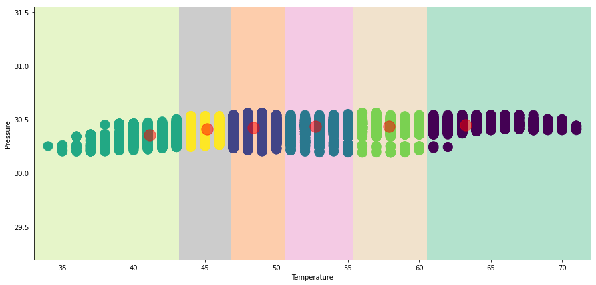
Variable interdependency Temperature vs Air Pressure
As Temperature increases Air Pressure increases. Cool temperatures cause air pressure to drop. When gas molecules cool, they move more slowly. Decreased velocity results in fewer collisions between molecules and air pressure decreases.

Slide 13
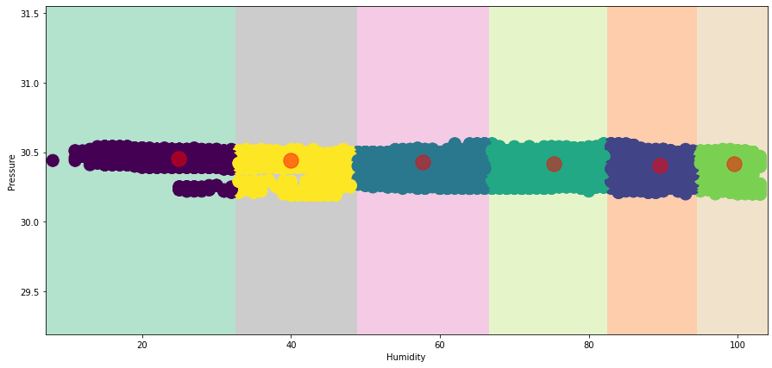
Variable interdependency Humidity vs Air Pressure
No correlation found between Air pressure and Humidity

Slide 14
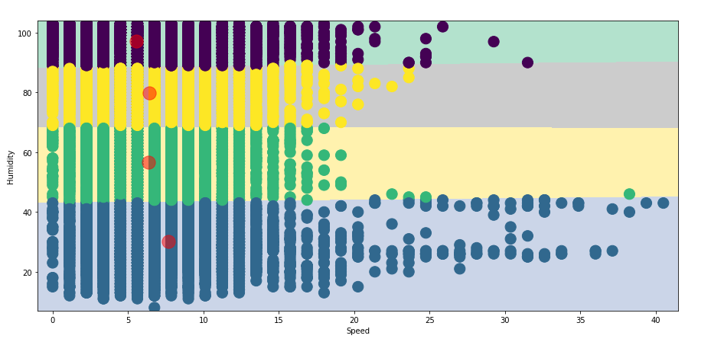
Variable interdependency Wind Speed vs Humidity
Wind speed seems to be inversely proportional to Humidity at low and high speeds.
Reason is unknown.

Slide 15
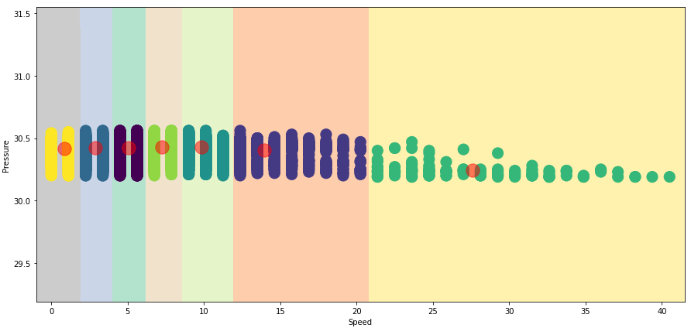
Variable interdependency Wind Speed vs Air Pressure
Wind speed is more when Air Pressure is less. The greater the difference between the high and low pressure or the shorter the distance between the high and low pressure areas, the faster the wind will blow.

Slide 16
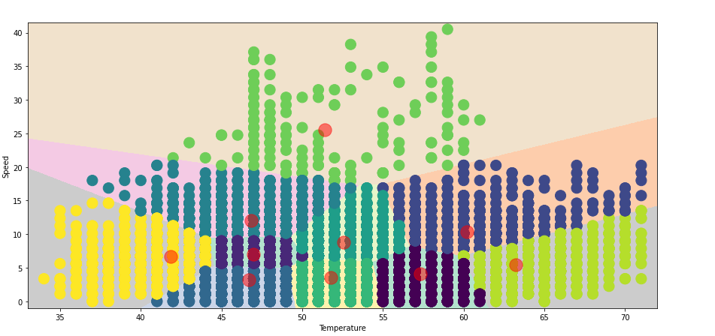
Variable interdependency Temperature vs Wind Speed
Absolutely no correlation between Temperature and Wind Speed

Slide 17
Correlations found
Temperature α 1/Humidity
Temperature α Air Pressure
Wind speed α 1/Humidity
Wind speed α 1/Air pressure

Slide 18
Variables considered for Radiation prediction.
Temperature
Pressure
Humidity
Wind Direction
Speed
UNIX Time

Slide 19
Algorithms for Radiation prediction
Linear Regression
RidgeCV
Decision Tree Regression
Support Vector Regression
SGD
ADABoost
XGBoost

Slide 20
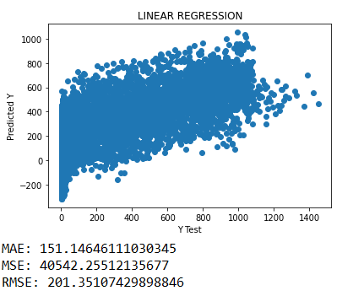
Radiation prediction – Linear Regression

Slide 21
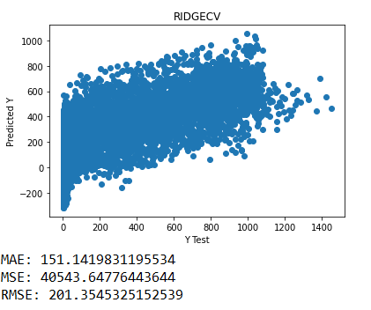
Radiation prediction – RidgeCV

Slide 22
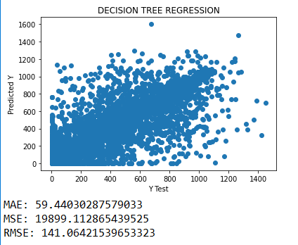
Radiation prediction – Decision Tree Regression

Slide 23
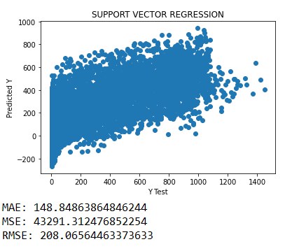
Radiation prediction – Support Vector Regression

Slide 24
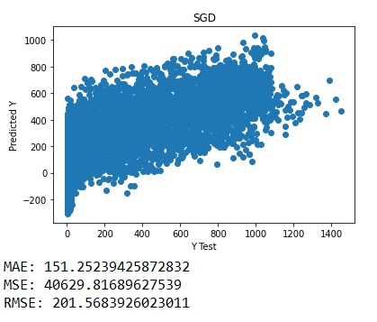
Radiation prediction – SGD

Slide 25
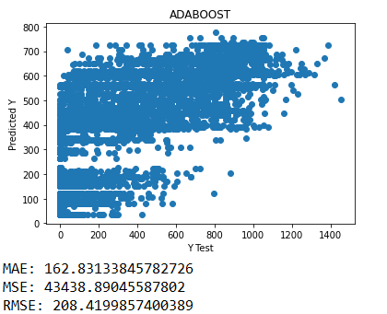
Radiation prediction – ADABoost

Slide 26
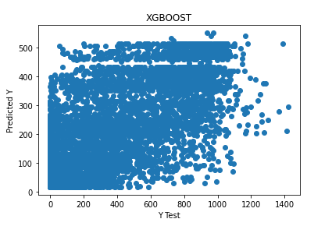

Radiation prediction – XGBoost

Slide 27
Most successful model – Decision Tree Regression
It has the lowest MAE, MSE, RMSE

Slide 28
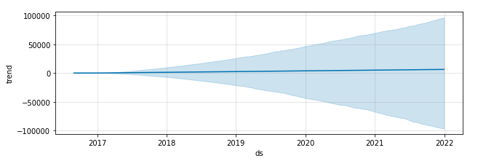
Predicting future radiation values using fbprophet
While looking at the prediction it seems that radiation will keep on increasing in the future.
However we had data for only 4 months so I would say take this prediction with a grain of salt

